Slide 1
MEGABLOCKS: EFFICIENT SPARSE TRAINING WITH MIXTURE-OF-EXPERTS

Slide 2
问题：
现有的系统限制了MoE的动态路由，必须在模型质量和硬件效率之间进行权衡
在计算中浪费token，要么通过填充浪费计算和内存
有效计算moe的挑战是处理动态路由和负载不平衡计算。现有的深度学习硬件和软件很难应对这一挑战。
TPUs and their XLA compiler require all tensor shapes to be known statically
GPU, the sparse computation in MoEs does not map cleanly to the software primitives supported in major frameworks and libraries.

Slide 3
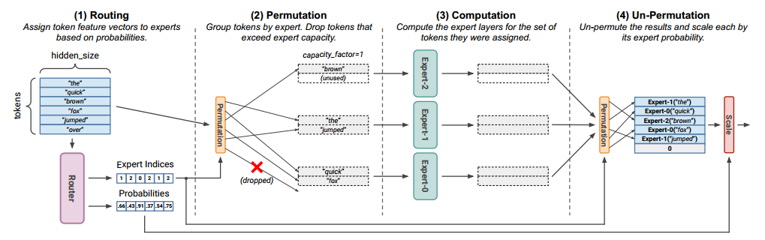
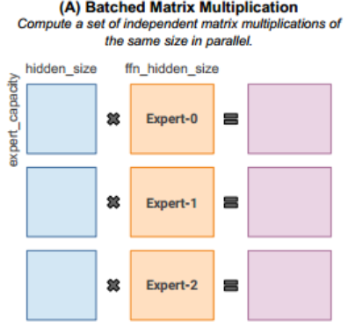
背景
最先进的MoE实现旨在并行计算所有专家层，以便有效利用gpu和tpu上可用的并行性
The standard primitive used by implementations is batched matrix multiplication, which computes a set of matrix products of the same shape (see Figure 3A).
This hyperparameter represents a tradeoff between additional computation and model quality.

Slide 4
问题：
现有的系统限制了MoE的动态路由，必须在模型质量和硬件效率之间进行权衡
方法：
reformulate MoE computation in terms of block-sparse operations and develop new block-sparse GPU kernels
效果：
enabling end-to-end training speedups of up to 40% over MoEs trained with the state-of-the-art Tutel library and 2.4× over DNNs trained with the highly-optimized Megatron-LM framework

Slide 5
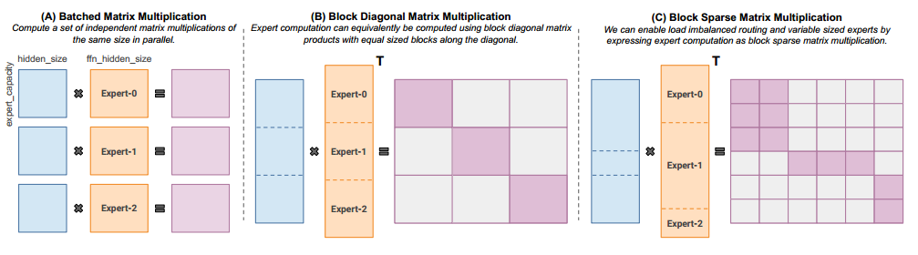
NO-TOKEN-LEFT-BEHIND WITH BLOCK SPARSITY
h
h

